Slide 1
PLINOVODI d.o.o.
Transmission System Operator for gas in Slovenia

Slide 2
Plinovodi
General facts
TSO for gas in Slovenia,
100 % owned by Geoplin d.o.o. Ljublajna,
ITO model according to EU legislation,
app. 150 employees,
app. 1150 km of high pressure pipelines,
transmission of natural gas through the Slovenian natural gas transmission system,
planning and development of the natural gas transmission system,
calibration and maintenance of gas meters and correctors,
education of those working in the energy industry.

Slide 3
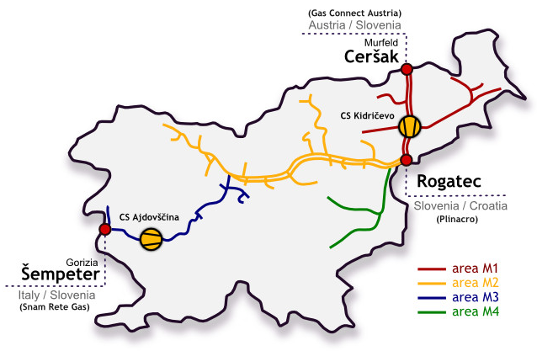
Plinovodi
General facts₍₂₎

Slide 4
Plinovodi
Slovenian natural gas market
over 300 direct connections,
large industrial users,
distribution system operators, which provide natural gas to 74 municipalities with a population of more than 1,3 million inhabitants,
annual supply in Slovenia at app. 900 mio cubic meters,
around 15 active balancing groups,
user and shareholder of PRISMA – capacity booking platform.

Slide 5
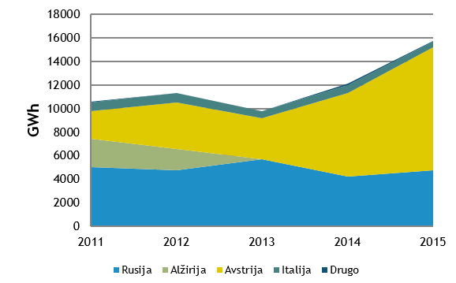
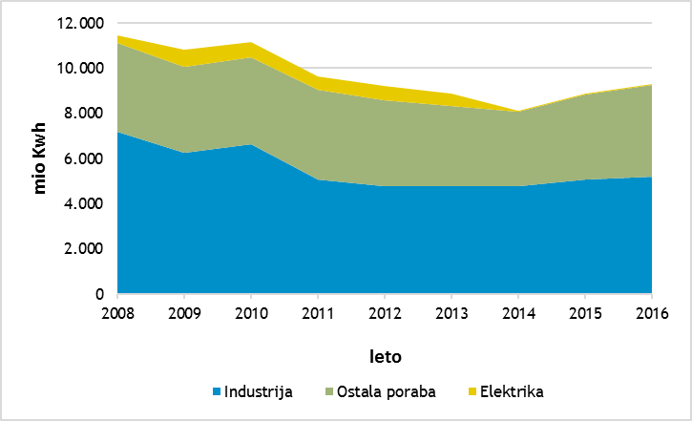
Plinovodi
Facts about use of gas in Slovenia

Slide 6
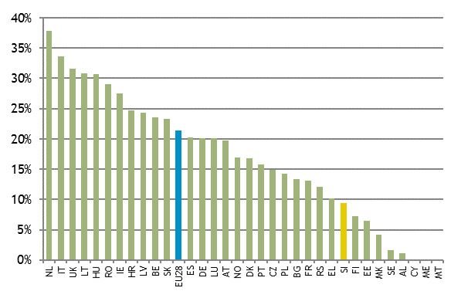
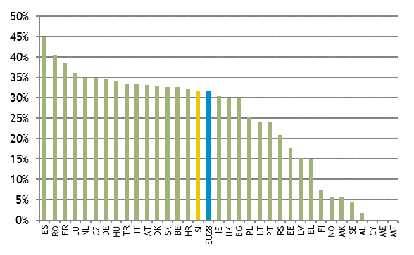
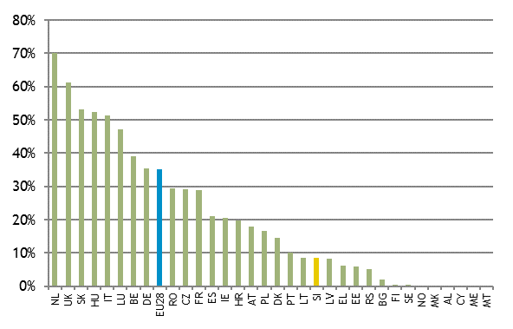
Plinovodi
Facts about use of gas in Slovenia

Slide 7
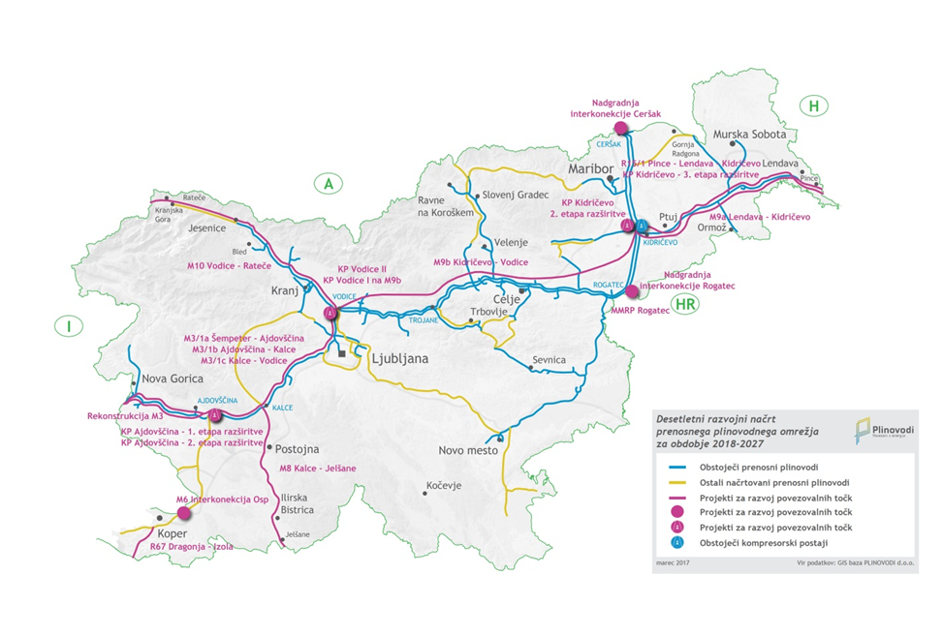
Plinovodi
Development projects

Slide 8
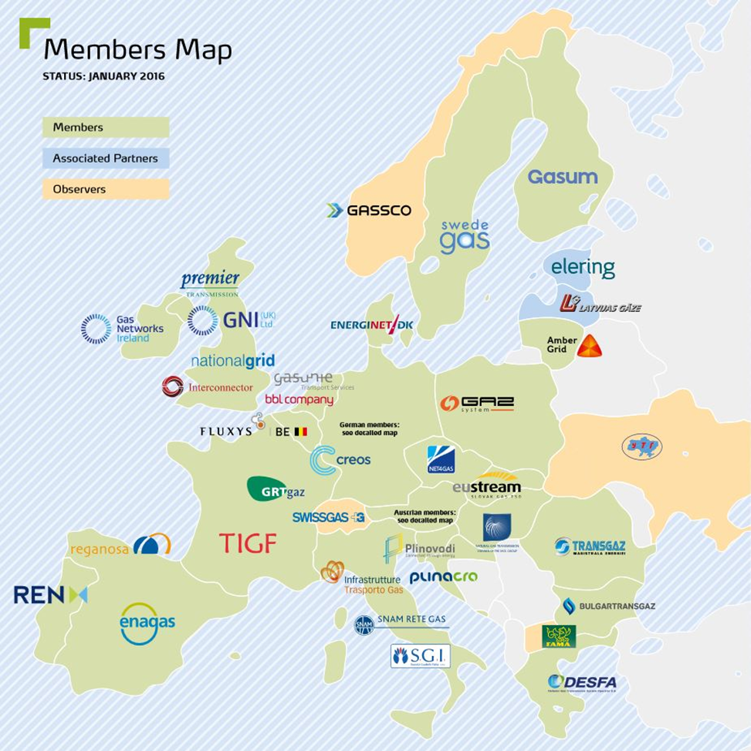
Plinovodi
ENTSOG

Slide 9
Thank you for your attention.

