Slide 1
Strengthening energy literacy through building a coalition of experts
Case study:
EN-LITE energy literacy project
(www.en-lite.si)
Mojca Drevenšek,
EN-LITE Society for strengthening energy literacy (president)
and Consensus Communications (consultant)
IGU – Marketing and Communications Committee
Study Group: Public Acceptance and Stakeholder Engagement
March 2017, Plinovodi, Ljubljana

Slide 2

From EN-LITE to key public acceptance issues
3. The way we work
2. Our activities (outputs)
1. What is
EN-LITE?
Communications
Collaboration
Trust
Stakeholder engagement
Outreach

Slide 3
Key challenges tackled in the presentation
How and why to build a coalition among experts? Where does it help?
How to offer common ground to the expert stakeholders?
Which communication tools/channels to use?

Slide 4
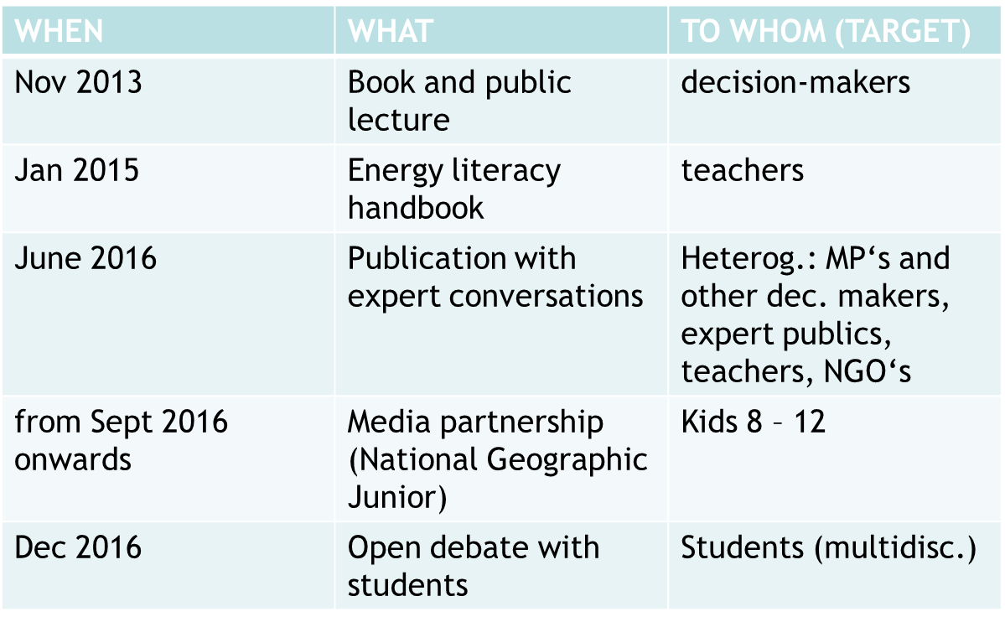
EN-LITE 2013 – 2017 highlights overview
Five key OUTPUTS
(communication tools/channels/activities):
NB:
>>> Lesson learnt:
- ...

Slide 5
1 – book and public lecture (Dec 2013)

Slide 6
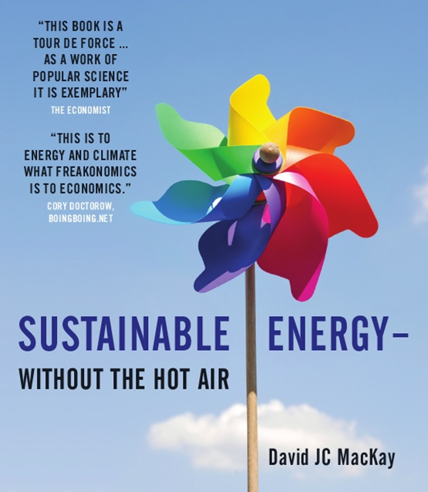
Numbers not adjectives
“This is a straight-talking book about the numbers. The aim is to guide the reader around the claptrap to actions that really make a difference and to policies that add up.“
(David MacKay,: “Sustainable Energy – without the hot air”, 2009)
>>> Lesson learnt:
foreign expert > public event
enter the decision-makers „home“
get the decision-makers around the same table

Slide 7
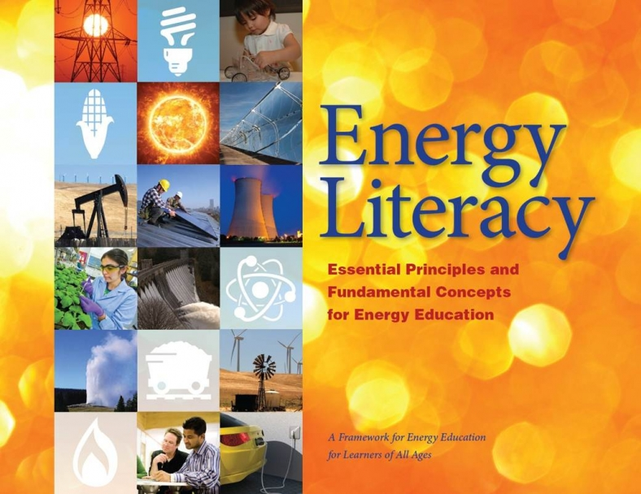
2 – Energy Literacy handbook (Jan 2015) original by US DOE

Slide 8
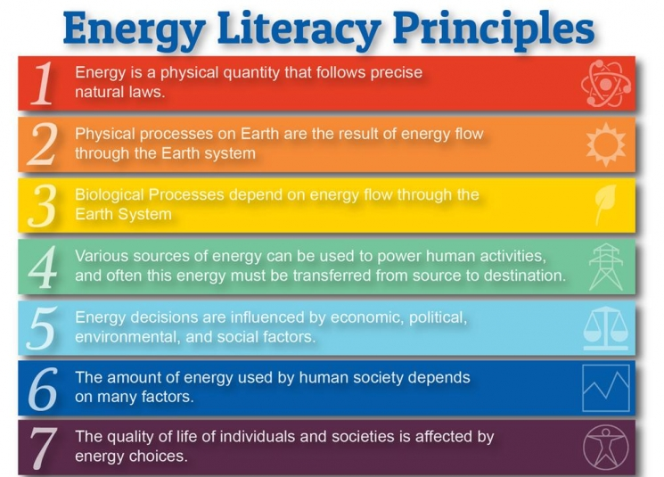
>>> Lesson learnt:
offer a theoretical / conceptual framework (the importance of being part of the puzzle)

Slide 9
3 - publication: „Energy and us – conversations with experts“ (June 2016)

Slide 10
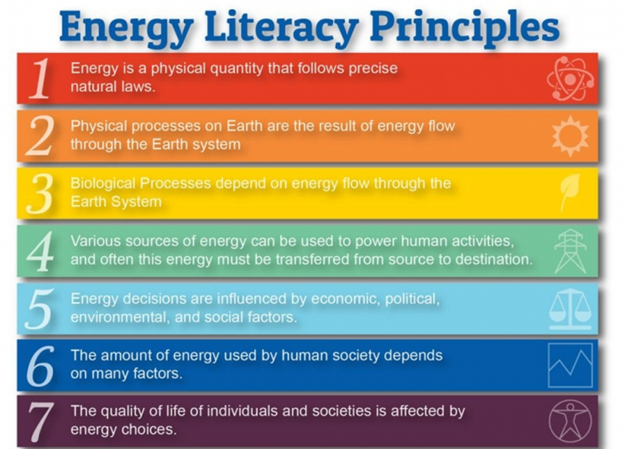
publication‘s table of contents

Slide 11
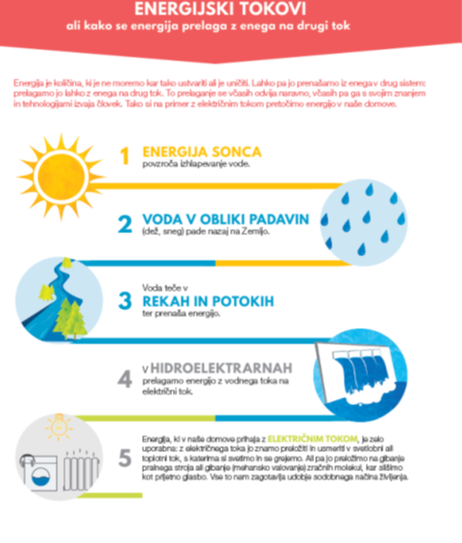
Attractive infographics
(new ways of seeing ‚the same old stuff‘)

Slide 12
e.g.: expert interview about the Slovene natural gas transmission and distribution system
>>> Lessons learnt:
communicate through text and graphics
messages in accordance with the conceptual framework > broad array of experts
create safe environment

Slide 13
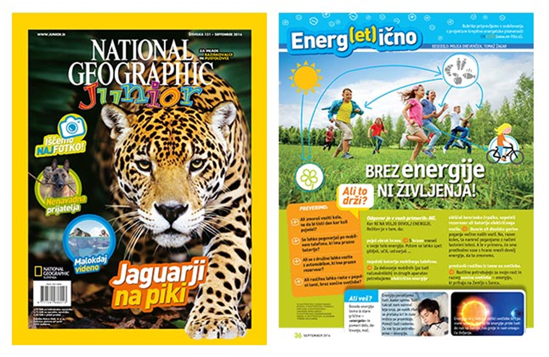
4 – partnership with the media
(National Geographic Junior in 2016/17)

Slide 14
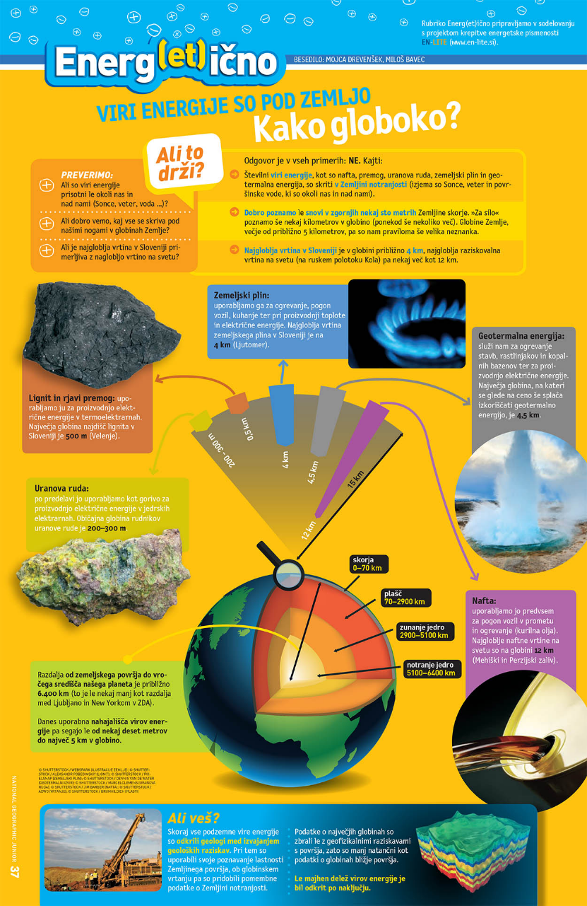
e.g. November 2016 issue: Energy sources are beneath the Earth‘s crust: How deep?
Challenge:
how to explain energy to kids aged 8 – 12?
about natural gas
>>> Lessons learnt:
communicate every-day life related facts
communicate interesting/outstanding facts
use plenty of (info)graphics
+ again: stick to the conceptual framework (editor, teachers ... further development)

Slide 15
5 –debates with students
>>> Lessons learnt:
young educated people > our future!
multidisciplinary approach (they need to hear each other, not just the experts)
stimulate conversation, offer further opportunities for collaboration

Slide 16
Lessons learned – wrap up*
(*energy literacy point of view but hopefully applicable to your fields of work)
Build a broad coalition of experts (tech.+nat. sc.+soc.sc.)
Create common ground through a conceptual framework
Show passion for (their) STEM - science, technology, engineering, mathematics
Be clear about target publics and project‘s objectives
  decision-makers > global/foreign insights
  students > learning, discussing
  teachers/mentors > tools for (easier) teaching about energy issues
  Have a positive and future oriented attitude

Slide 17
Link to IGU Study Group‘s Public Acceptance Model:
The role of expert‘s coalition in gaining public acceptance for energy infrastructural projects

Slide 18

EN-LITE project:
Thankful for your feedback, open for international collaboration!
www.en-lite.si
info@en-lite.si
mojca.drevensek@consensus.si
EN-LITE 2016 Annual Report (in Slovene)

