Slide 1
Marketing and Communications Committee
Communicate!
Amsterdam, September 2015

Slide 2
Study groups themes
Clean air & public communications (Tracy)
Public acceptance & communications (Marcel, Dimitri)
Gas innovation & marketing campaigns
(Anja/Phil)

Slide 3
MCC members
Hansch van der Velden - Gasunie
Barbara Jinx – LNG18
Anja Hulshof – Energy Delta Institute
Guy Broggi - Total
Frazer Hill - Jemena
Markus Solinger – Swiss Gas Association
Keith Boulton – Union Gas
Malgorzata – Gaz System
Tracy Burleson - AGA
Akmal Zaghloul – TAQA Arabia
Marcel Hoenderdos - EBN
Marieke Kanon - Gasterra

Slide 4
Cooperation with IGU Presidency
Support IGU clean air ‘campaign’ with focus on public messaging .
Provide ongoing assistance of the IGU Strategic Outreach & Communications Group.
IGU to amplify committee topics via their portal, newsletter, LinkedIn, media launch, magazine, webcast, online surveys.

Slide 5
Cooperation with IGU Presidency details
IGU clean air ‘campaign’ request to MCC
Translate to messaging (Mega Cities) for public
See how to raise public awareness of topic in Europe and elsewhere
Provide input on the approach taken by IGU for opinion leaders
Policy asks?
Tracy coordinator (obtain reports), Keith provides 1st draft of public messaging
Ongoing assistance of the SOC in communications including
Strategy and messaging
Media & speaking opportunities: help prepare answers or content
Specifically: speakers academy (subject matter experts + advisors)
What is on radar: policy experts, policy writers, published studies, proof xxx
Input into editorial calendar
MCC input into the current setup of the IGU Magazine (next meeting, with Anette)
Input on social media approach by IGU
IGU will amplify MCC topics (portal, newsletter, LinkedIn, media launch, magazine, webcast, online surveys…).

Slide 6
Calendar meeting
Berlin 23 – 25 Feb 2016 (Host is WinGas, joint strategy & innovation SME)
Asia 3Q 2016 (China, HK?, Brisbane)
Canada 2Q 2017
Rio Oct 2017 (with IGRC in Rio)
Norway Feb 2018 (joint with innovation)
Washington June 2018
X joint meeting sustainability committee TBC.

Slide 7
Next meeting Berlin
Air emissions campaign
Keith & Tracy lead on Presentation clean air, request Jason B or other guest speaker
Review policy documents this topic, also outside of industry
Feedback on IGU messaging
Innovation
Guy on LNG status w. angle on clean air, public acceptance and innovation
Markus presentation on campaign on heat conversion
Public acceptance
Hansch & dimitri presentation + thought leadership public acceptance
Webcast on public acceptance & topic (series kick off)

Slide 8
Other future presentations
Guy: geopolitics + the wave of LNG and what is will bring us
Frazer: consumer marketing, NSW
Markus: transition to gas heaters
Keith: energy efficiency & commercial
Malgorzata: public acceptance for IS projects
Tracy: boost gas usage in summer, research of new app for gas usage
Gerard Linke: chair of innovation committee on gas innovations especially power to gas
Anja: earthquakes NL learnings + access to SME / Russians + intercultural differences + ENECO and innovations in gas (mini MBA)
Dimitri: public acceptance
Hansch: the Dutch case and how we manage this. Define jointly a gas proposition. What is KVGN doing. Value driven communications.
Barbara: lost fight against the greenies
Outside speakers: Edelman, Goda / Linda, CSIRO (Frazer),

Slide 9
MCC participant wish list
China – clean air (barb)
Korea (Kogas) (barb)
Japan innovation (Guy)
David K – REW (tbc)
Towngas HK (Guy)
Gascco, Kjell (dimitri)
Yemen LNG (dimitri)
Shell – Alex (dimitri)
Patrick Pelle (dimitri)
Chevron (barb)
Omv (dimitri)
Sedigas / GNF (barb)
Eon – Caroline (barb)
Petrobras (dimitri)
Engie (michel lemen/who else: dimitri)
Tracey (eurogas > barb)

Slide 10
MORE TO DO’S
Distribution list (dimitri)
Dropbox for sharing (dimitri)
Whatsapp group (barb)
Barbara and Eren on clean air follow up on Instanbul (barb)
Speaker in Berlin DGDW / Barbara to arrange + innovation (P2G, transportation, innovation end user residential) (barb)
IGU speakers database (Anja) draft by next meeting
Policy documents inventory per three studygroups (clean air, PA, innovation) > content and proof
US examples of air campaign from other industries (tracy)
Send around article and report PA to new MCC group (dimitri)
Edelman Trust Barometer – presentation in Berlin (Tracy)
Audi speaker next meeting (markus)
Speaking slot IGRC Rio (hansch)
Berlin site visit / marketing P2G (barb)
Coal industry in Poland (air)speaker? (margaret)
Change name PA studygroup with IGU (dimitri)
Global Compact (UN) (Matgorzata)
World Bank & clean air mega cities / + WHO (Tracy)
Turn it on video on dropbox
Results from Turn it on campaign by Frazer + speaker from Japanese agency

Slide 11
MCC members priorities
Frazer: get more customers using more gas – interest is innovation in gas applications for customers, new uses of gas in summer and gas in transport. Success and failure in this area.
Keith: defend market looking at clean air - and climate policy and how distribution companies deal with this? With transport as a big opportunity. Learn form the group. What worked well in marketing campaign, what did not work well. How do we push the switch for car owners. How does it improve your life style / quality of life. What if we drop clean, now what?
Matgorzata: communication needed on advantages of natural gas to be used in our own market. How to advocate this in Poland. Mostly for public.
Markus: how to position gas versus oil/coal. How to position it as a clean energy. How much renewables gas will we get in our pipelines. Can we build a brand of natural gas. Communications towards politicians and end consumers.
Guy: natural gas will play key role in energy mix, oil is rapidly declining. Therefore how to promote gas – in combination in renewables. This is about the image of gas. Transportation is of particular importance. NG needed. Clean air makes sense.
Tracy: learn about new markets and new technologies.
Anja: what are the topic that are relevant for the young professional and EDI participants.
Hansch: how to communicate to people at different stages (earthquakes, MH17 and Ukraine, energy policy where gas is marginalized). How do we define ‘together’ with our opposition the role of NG. Who do people still trust? What does this mean for our jobs? Conversation. IGU to step up its game to engage and have clear results.
Barbara: be useful for the IGU. Shared learning. Have tangible deliverables. Therefore also link with Mel.

Slide 12
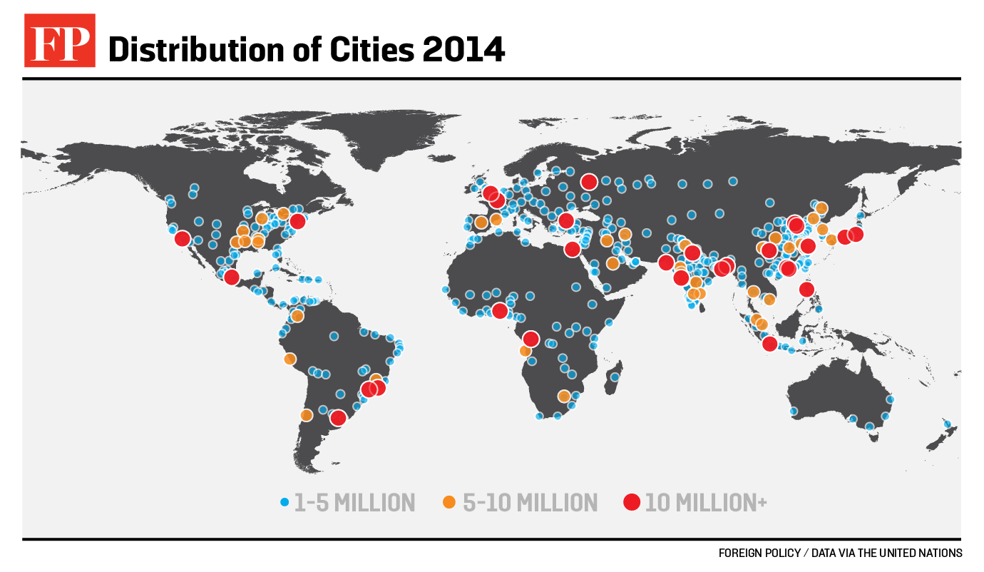
A Natural Partnership: Gas and Clean Air
Twenty seven mega-cities in the world
By 2030, the world is projected to have 41 mega-cities
Notes:
Today there are 27 mega cities in the world. A mega city is defined as more than 10 million inhabitants.
By 2030, the world is projected to have more than 41 mega-cities.

