Slide 1
Marketing and Communication Committee
Amsterdam, The Netherlands
September 7 – 9, 2015

Slide 2
A Natural Partnership: Gas and Clean Air
This group will look at examples of where gas has improved quality of life through reducing air pollution in mega-cities and campaigns that successfully communicate the contribution of gas to cleaner air. We will explore potential affiliations with organizations that are involved in improving the quality of live through cleaner and facilitate IGU making those connections.

Slide 3
A Natural Partnership: Gas and Clean Air
Where has gas improved quality of life through the reduction of air pollution in mega-cities?
Are there campaigns that successfully communicate the contribution of gas to cleaner air?
Are there organizations that are involved in improving life through cleaner air and can we facilitate IGU making connections?
Notes:
As the first task of the study group, we will answer the following three questions..

Slide 4
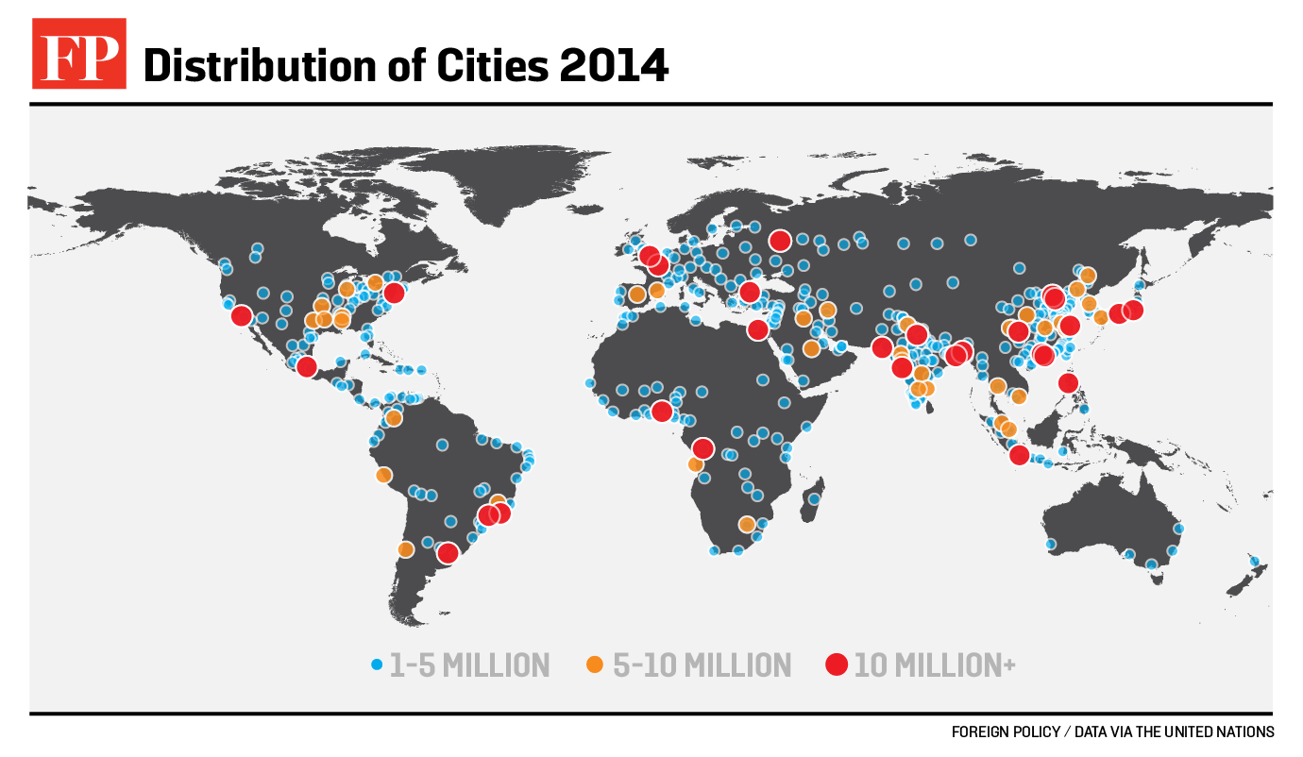
A Natural Partnership: Gas and Clean Air
Twenty seven mega-cities in the world
By 2030, the world is projected to have 41 mega-cities
Notes:
Today there are 27 mega cities in the world. A mega city is defined as more than 10 million inhabitants.
By 2030, the world is projected to have more than 41 mega-cities.

